Slide 1
Epworth Forest Administrative Committee Annual Meeting 8/12/17

Slide 2
Meeting Guidelines
Welcome to our Annual Meeting.
Do we have any new neighbors present.
Hold all questions to end of meeting.
Respect others opinions and questions.
Meeting time 9 – 10:30 AM.

Slide 3
Directors
Sharon Anson – President
Dick Presser – Vice President
Kara Lusby – Secretary
Suzanne Montovani – Treasurer
Tom Earhart – 5th/Neutral Director

Slide 4
Order of Business
Minutes of Annual Meeting 2016
President’s Report
Legal Cases
Significant responses from Court Decisions
Introduce new Director – G.Powell
Status of On Shore elections
Financial Report
Community Pier
DNR Application
2nd Trail
Future
Communications/website
Concerns

Slide 5
Legal Cases 9/16 – 8/17
Powell vs EFAC & Appeal
Stine vs EFAC
Conflict of Interest
DNR 2nd Trail

Slide 6
Community Pier
DNR Application
Current location/Kokomo Grace
2nd Trail

Slide 7
Shoreline Piers Budget 2017
General Pier Fees Budget Amount
Administrative Committee Liability Insurance $770
Link Accounting $300
Fith Paid Committee Member $4,000
Legal Expense
Legal Fund $10,000
Web Site $20
Office Supplies and Postage $100
Mail Box $50
Petty Cash $50
Total Budgeted Annual Expense $15,290
Total Budgeted Annual Income $15,500
On-shore Piers 100
Off-shore Piers 55
Community Piers 0
Total On-shore, Off-shore and Communitive Piers 155
Calculated Fee With Equal Billing $98.65
Rounded 2017 Fee $100

Slide 8
Community Pier Budget 2017
Community Pier Fees Budget Amount
Pier Install $900
Pier Removal / Storage $1,300
Pier Maintenance $2,000
Pier Replacement Fund $1,400
Community Pier Insurance $800
Office Supplies $0
Total Bugeted Annual Expense $6,400
Total Bugeted Annual Income $6,800
Number or Long Piers 16
Number of Short Piers 2
Long Pier Fee $376.47
Short Pier Fee $188.24
Rounded 2017 Long Pier Fee $400
Rounded 2017 Short Pier Fee $200

Slide 9
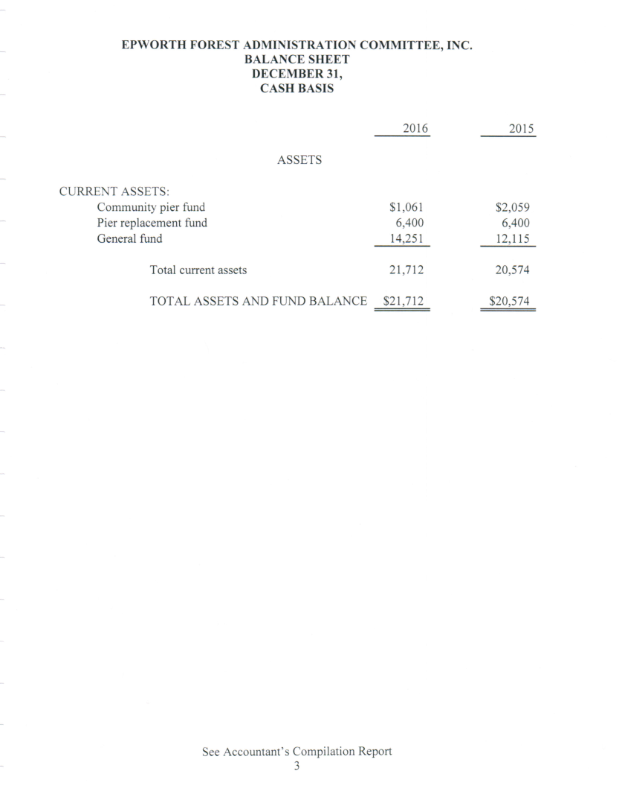
End of Year Financial Report 2016

Slide 10
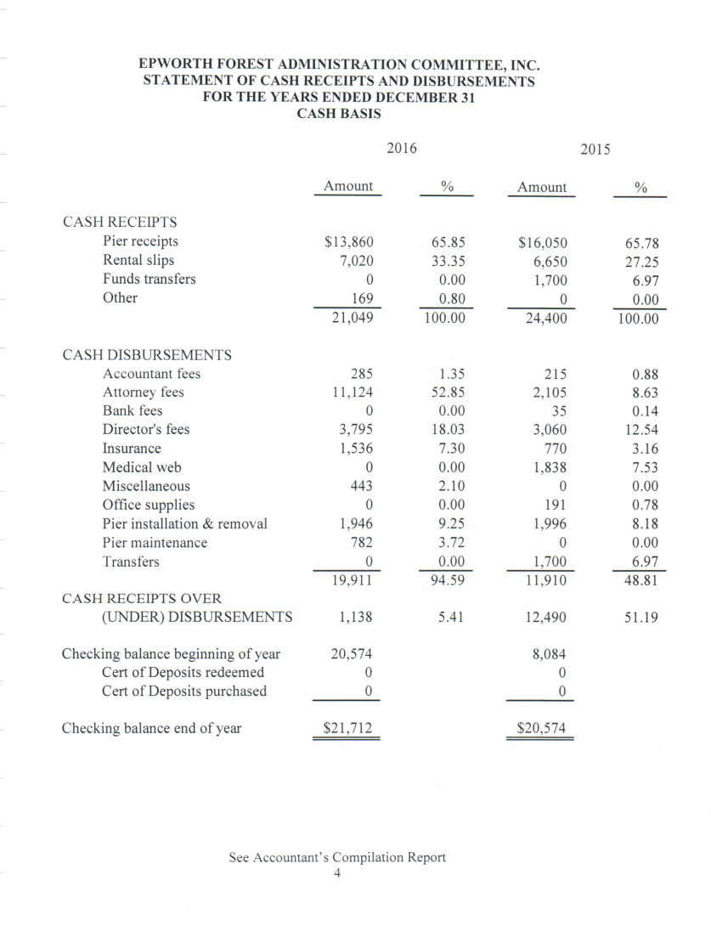
Financial Report

Slide 11
Communications/website

Slide 12
Concerns

